Slide 1
Monetary Policy Shocks on Asset Prices
Group 8:
Nicolas Yong Joon Lee
Giani Ranzetti

Slide 2
How Policy Changes Affect the Stock Market
Motivation for this research:
From 2009~2022, interest rates have been very low to stimulate economic growth
Since 2022, they are increasing in direct response to inflation and the rapid increase in monetary supply
Speculation surrounding future Fed decisions, such as interest rate cuts, can significantly influence stock prices today. Investors are already 'pricing in' these expectations.
Unforeseen information released to the public acts as an exogenous shock to expectations. This spills over to financial and macroeconomic variables
Jarociński, Marek & Karadi, Peter, 2018. "Deconstructing monetary policy surprises: the role of information shocks," Working Paper Series 2133, European Central Bank.

Slide 3
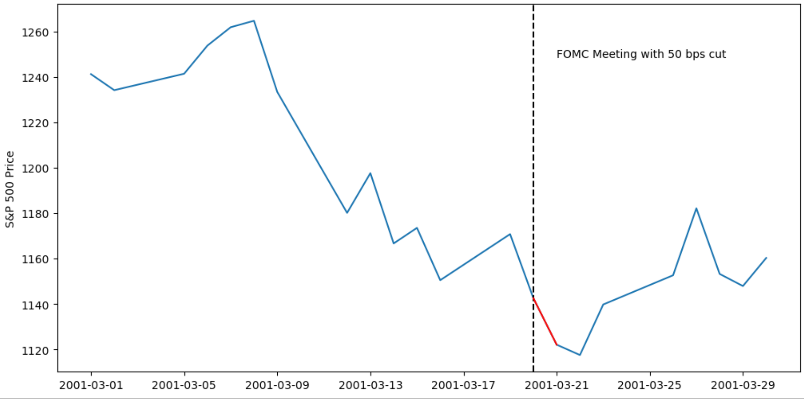
Theory Vs. Practice
On 20th March 2001, 50bps rate cut was announced
S&P 500 declined instead of rallying as economic theory would suggest
Fed simultaneously convey info about monetary policy and the economic outlook
“Substantial risks that demand and production could remain soft.”
-Alan Greenspan, Fed chairman of the Board of Governors

Slide 4
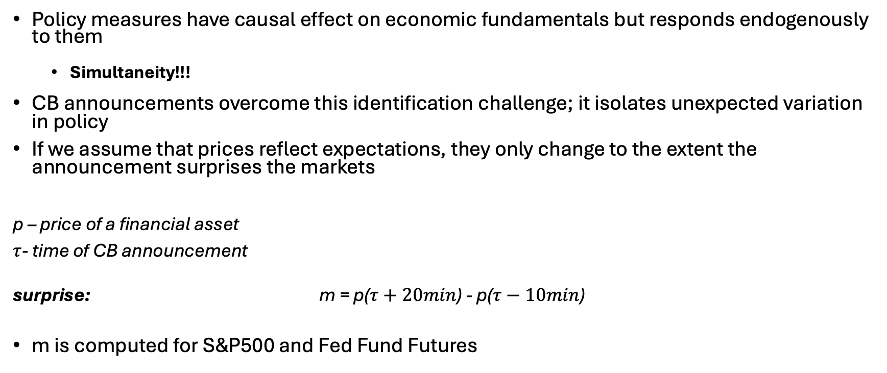
‘Surprise’ Variables
Policy measures have causal effect on economic fundamentals but responds endogenously to them
Simultaneity!!!
CB announcements overcome this identification challenge; it isolates unexpected variation in policy
If we assume that prices reflect expectations, they only change to the extent the announcement surprises the markets
p – price of a financial asset
$τ$- time of CB announcement
surprise: m = p($τ+20min$) - p($τ−10min$)
m is computed for S&P500 and Fed Fund Futures
Notes:
A positive surprise in the stock market implies a direct increase in stock price, a positive surprise in the treasury futures implies an interest rate increase.
As one would expect, forward rates at the short end of the yield curve increase following a surprise tightening of the federal funds rate (and decrease following a surprise easing). Since the federal funds rate has some persistence, as noted by many authors, tighter policy today leads to expectations that the federal funds rate will remain higher in the near future, thus pushing near-term forward rates in the same direction as the policy surprise
The price movement in Fed funds futures reflects the opposite of the expected change in the underlying interest rate. A higher expected future rate translates to a higher price for the Fed funds futures contract (because it locks in a lower rate compared to the new expectation)

Slide 5
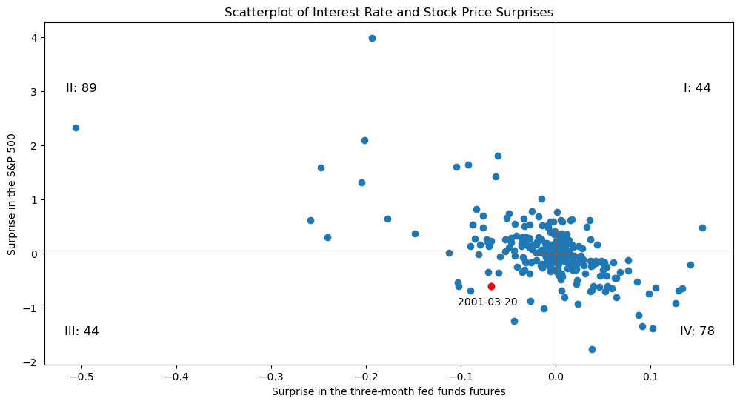
Wrong-Signed Responses of Stock Prices to Interest Rate Surprises
Quadrants II and IV: co-movement between interest rates and stock prices is negative (as predicted by textbook economics)
Quadrants I and III: counterintuitive positive co-movement
About a third of the data points are in quadrants I and III, with “wrong-signed” stock market responses

Slide 6
Single shock SVAR
Variables selected:
Surprise Variable(in percentage basis points), S&P 500 Index, GDP, 1Y Treasury Rate, Unemployment Rate, M2 Money Supply
After conducting the ADF-tests:
Not stationary: S&P500 index, GDP, M2, Unemployment Rate
Stationary: Surprise variable
Weakly stationary: 1Y Treasury Rate
Transformations:
Apply Log and after take the difference for S&P500 Prices and M2;
Same for GDP but first we deflated it by the CPI
First difference to unemployment rate
For this mode we decided to difference the 1Y Treasury

Slide 7
Single shock SVAR
Optimal Lag selection using AIC
3 lags (monthly data)
Use dummy variables for the periods with outliers:
3 Months in 2008
3 Months in 2020
We assumed that the surprise announcement variable is only affected contemporaneously by its own shock. (A matrix)
Further restrictions were imposed in the B matrix using economic intuition.

Slide 8
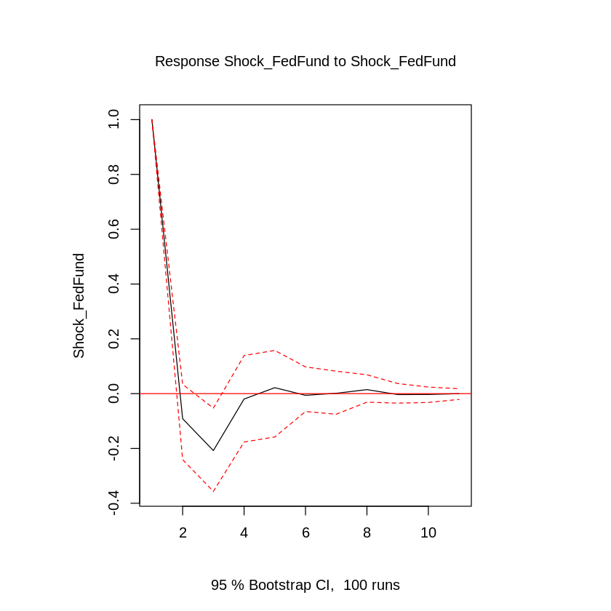
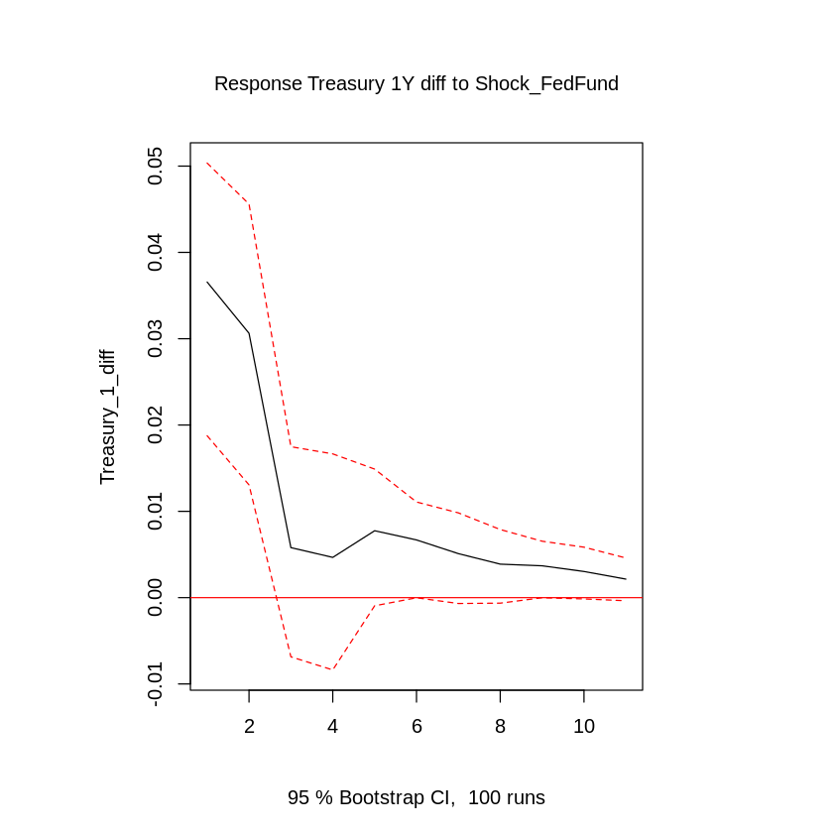
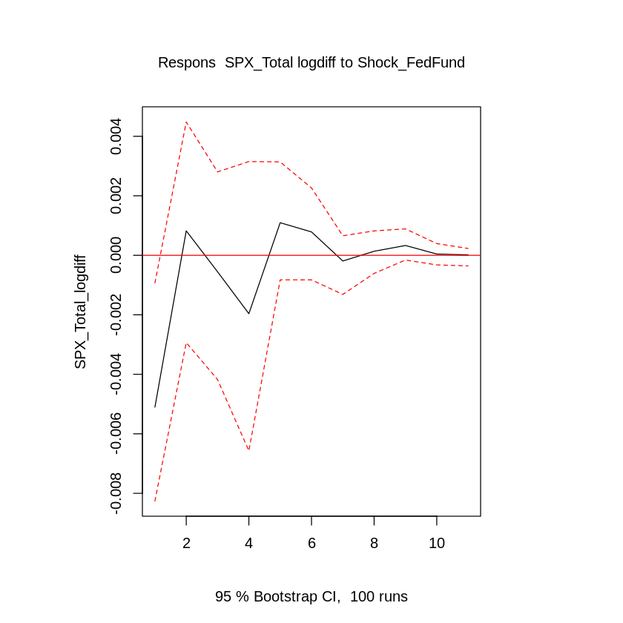
IRFs

Slide 9
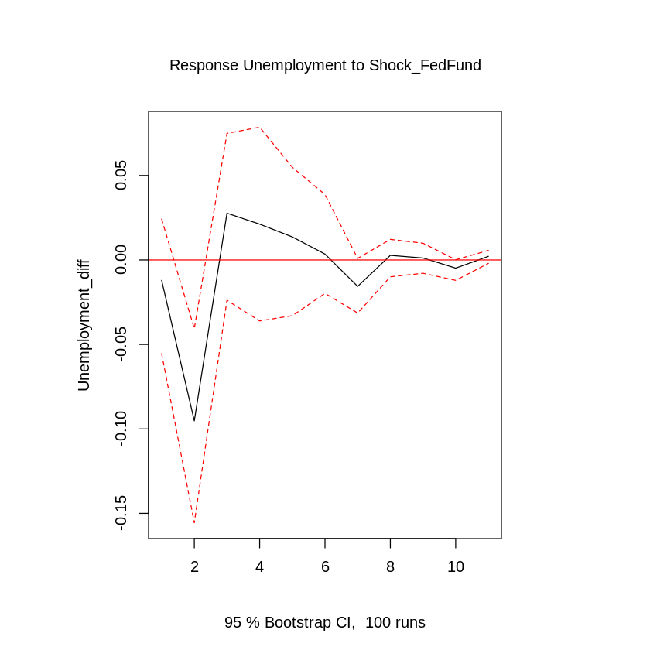
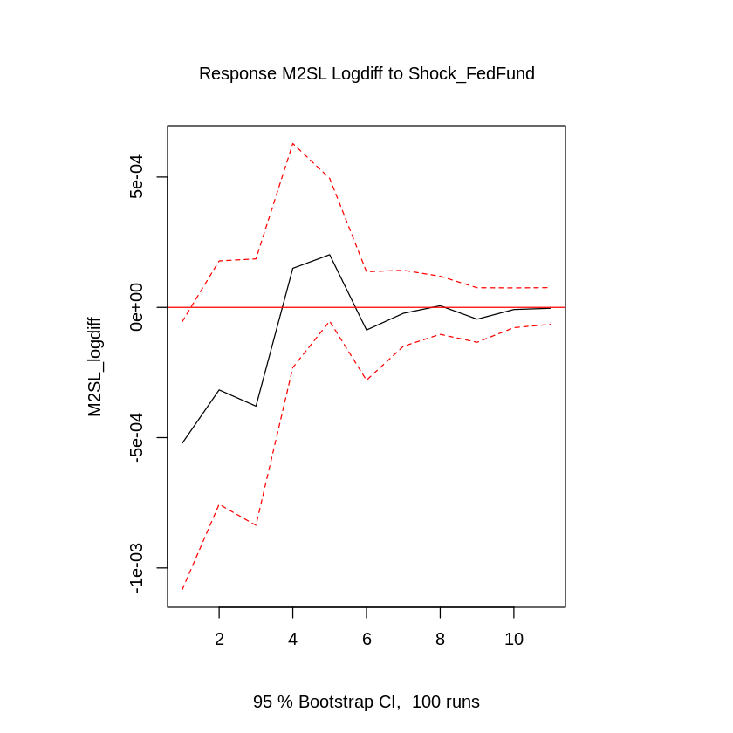
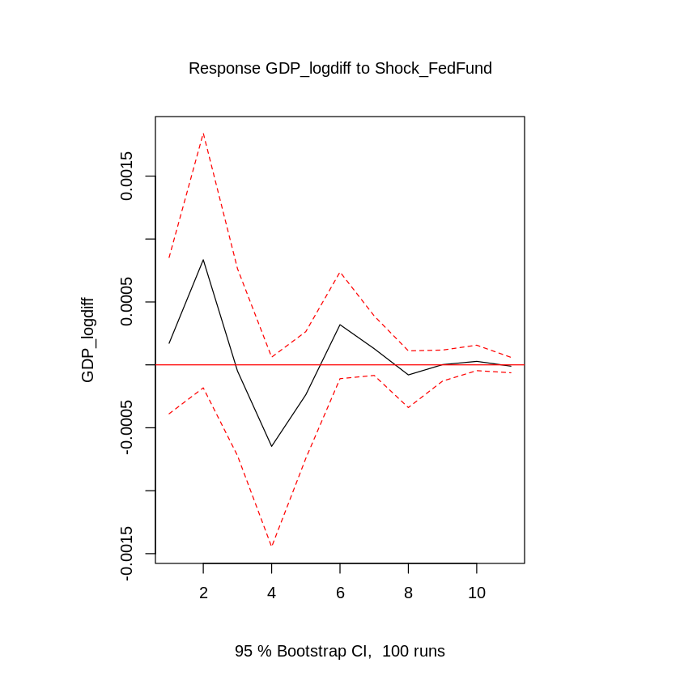
IRFs

Slide 10
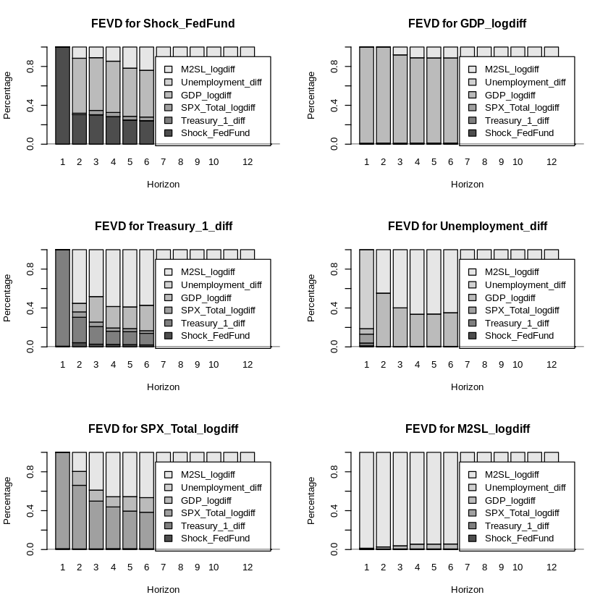
FEVD

Slide 11
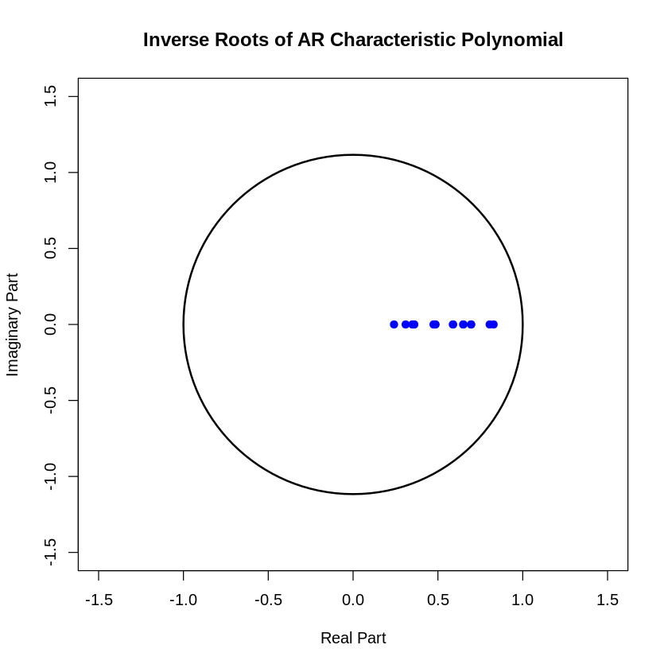
Diagnostic Tests
Stability of the model: Inverse of the AR roots are all inside the unit circle. OLS Cumu. Sum of residuals plots are also in the Appendix.
Normality Test (Jarque-Bera Test): Null hypothesis is rejected
LM Test for Autocorrelation (Breusch-Godfrey): Null hypothesis of no serial correlation between residuals is rejected. ACF and PACF plots in the appendix.
Test for Heteroskedasticity (Breusch-Godfrey):: Null hypothesis of homoskedasticity is rejected
P-values equal to zero.
Problems with model misspecification, more dummies for outliers needed

Slide 12
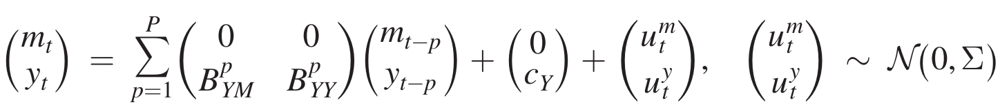
(Proxy) SVAR Model
Let y_{t} be a vector of N_{y} macroeconomic and financial variables observed in month t. Let m_{t} be a vector of i.i.d surprises in N_{m} financial instruments observed in month t.
Because m_{t} is i.i.d, it does not depend on lags of either m_{t-p} or y_{t-p} and has zero mean
Proxy SVAR methodology:
Surprise variables have been used as external instruments in the literature but lead to similar result
Notes:
External instrument: Presence of an instrument that is correlated with a shock of interest and uncorrelated with all other shocks

Slide 13
Identifying Restrictions
Assumptions:
Announcement Surprises are affected only by the 2 announcement shocks and not other shocks
A negative co-movement shock is associated with an interest rate increase and a drop in stock prices. A positive co-movement shock is associated with an increase in both interest rates and stock prices

Slide 14
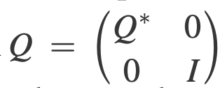
Identifying Restrictions
Step 1: Assumption 1 implies a block Cholesky structure on the shocks with the 2 shocks forming the first block
Step 2: Compute PQ where P is the Cholesky decomposition of the reduced form residuals 𝚺u
Step 3: Compute impact effects of shocks associated with PQ, check if sign restr. is satisfied
Step 4: Go Back to step 1 and repeat N times
All matrices in the set represent admissible solutions to the identification problem model is only set identified → Inflates error bands accordingly
where Q* is a 2x2 orthogonal matrix with elements drawn out from normal distribution

Slide 15
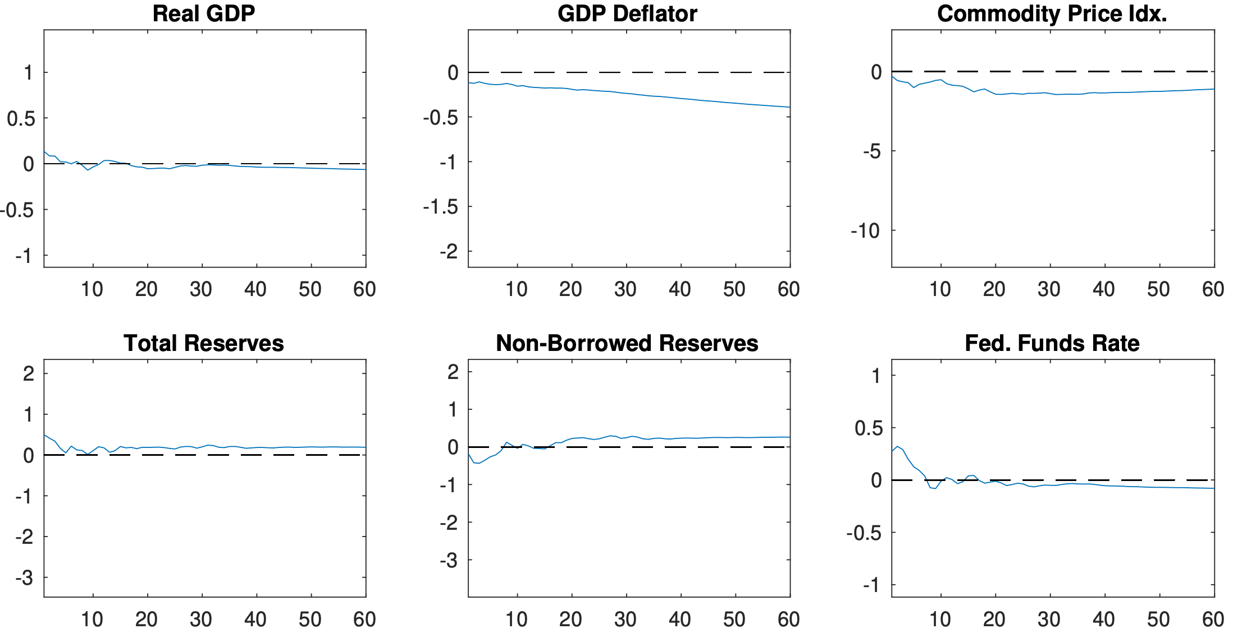
Sign Restriction Iterative Process

Slide 16
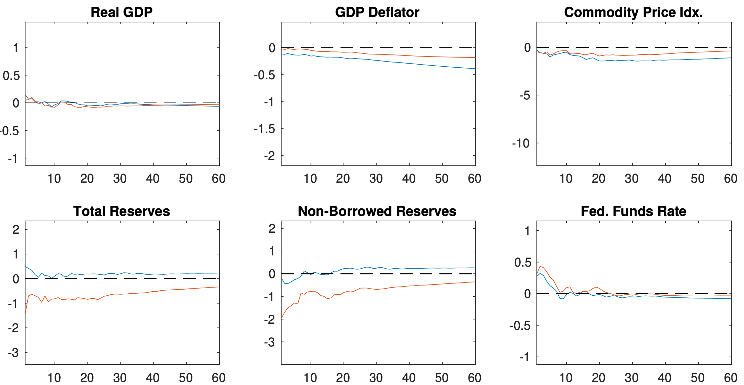
Sign Restriction Iterative Process

Slide 17
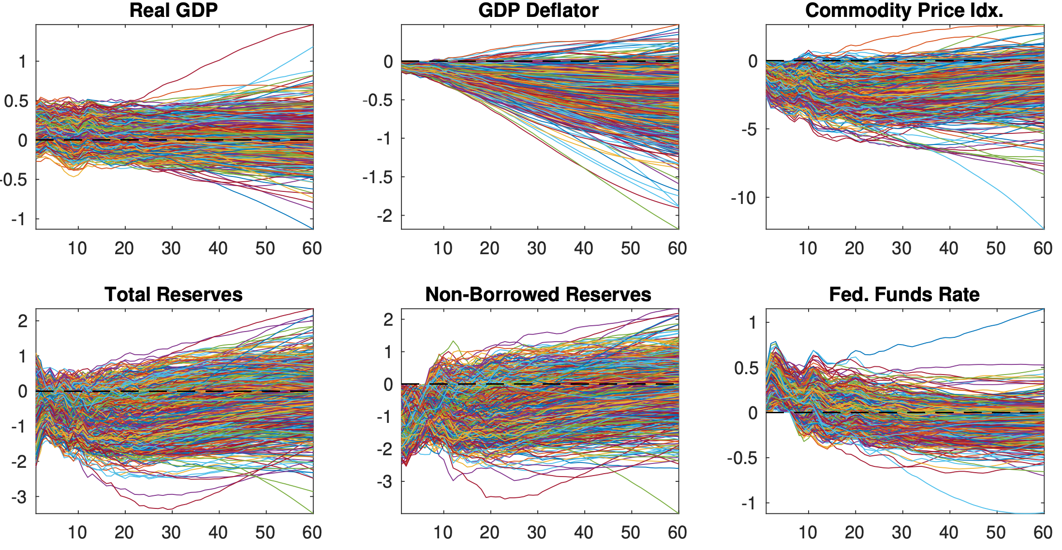
Sign Restriction Iterative Process

Slide 18
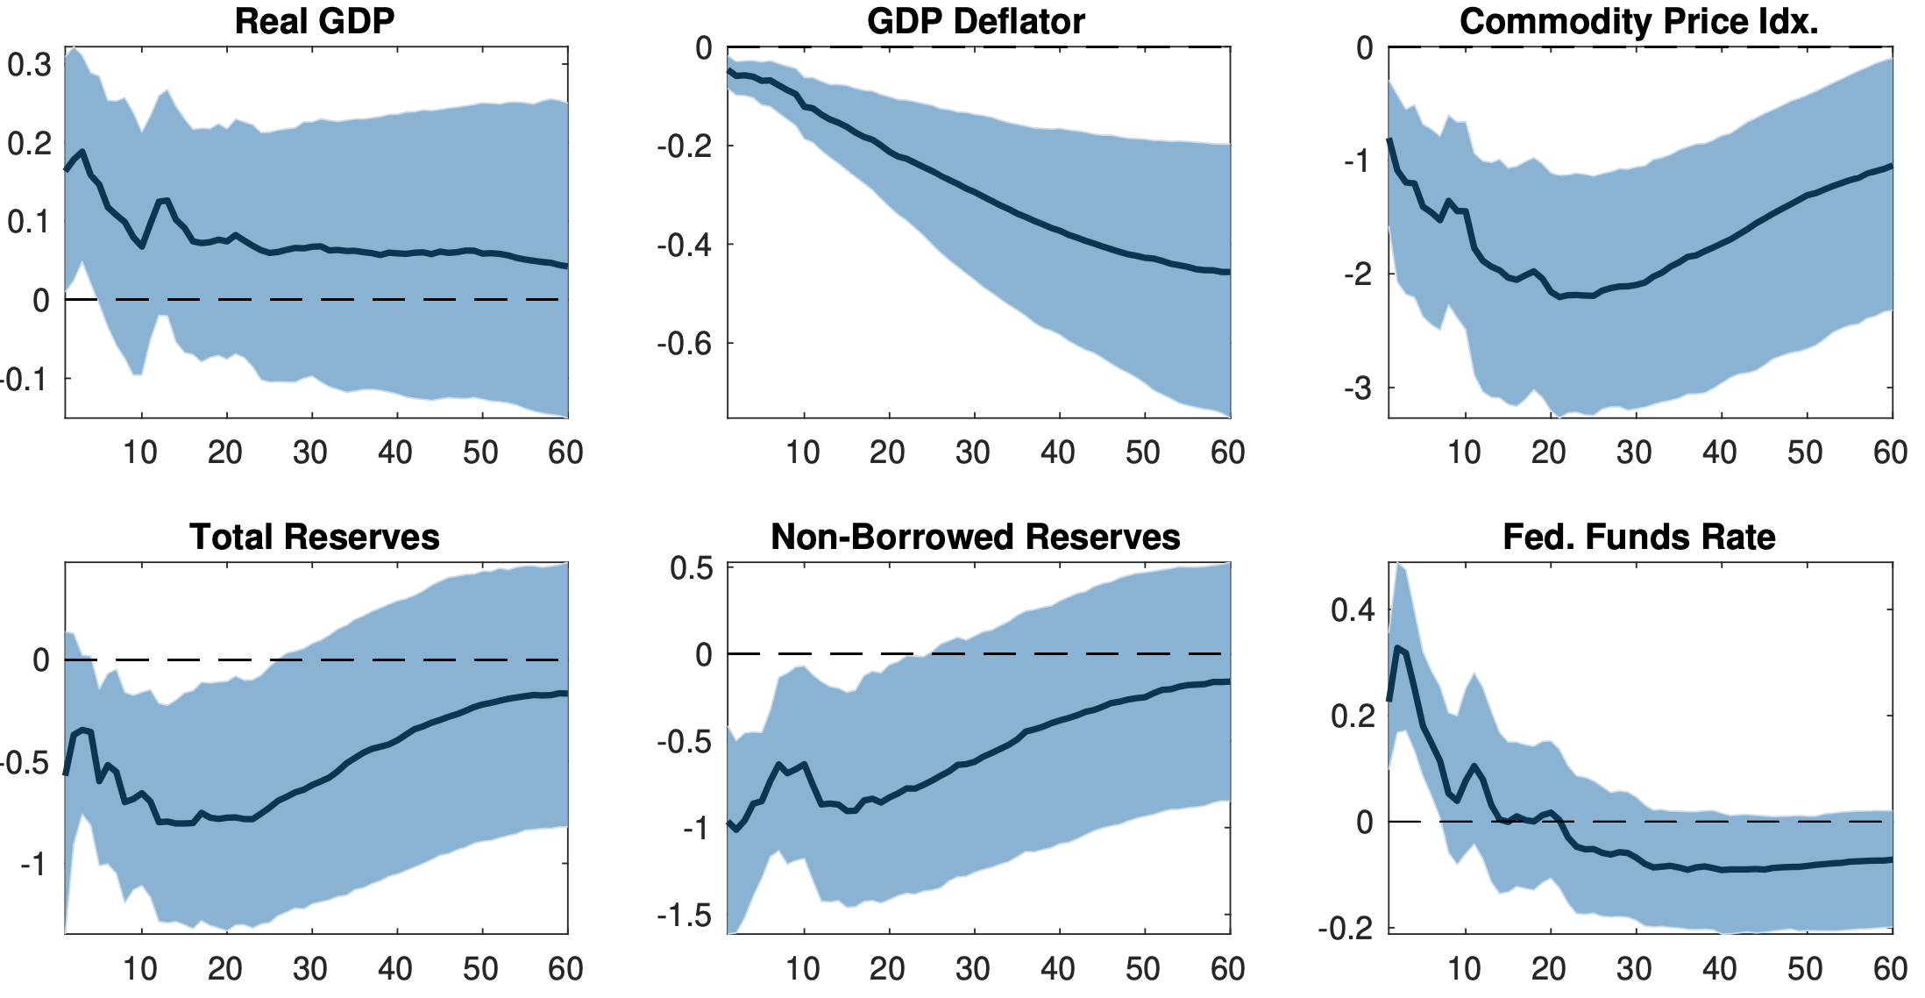
Sign Restriction Iterative Process

Slide 19
Variables
Exogenous Variables:
Treasury Futures surprise (∆ nominal price): 3-month Futures
S&P Surprise (∆ nominal price): S&P 500 price change
Endogenous Variables:
1-year Treasury yield (%): Monetary Policy indicator
S&P 500 (log x 100): Stock price index
Real GDP (log x 100): Real activity indicator
CPI in 2017 $ (%): Price level indicator
BAA corp. bond vs. 10y treasury spread (%): Financial conditions indicator

Slide 20
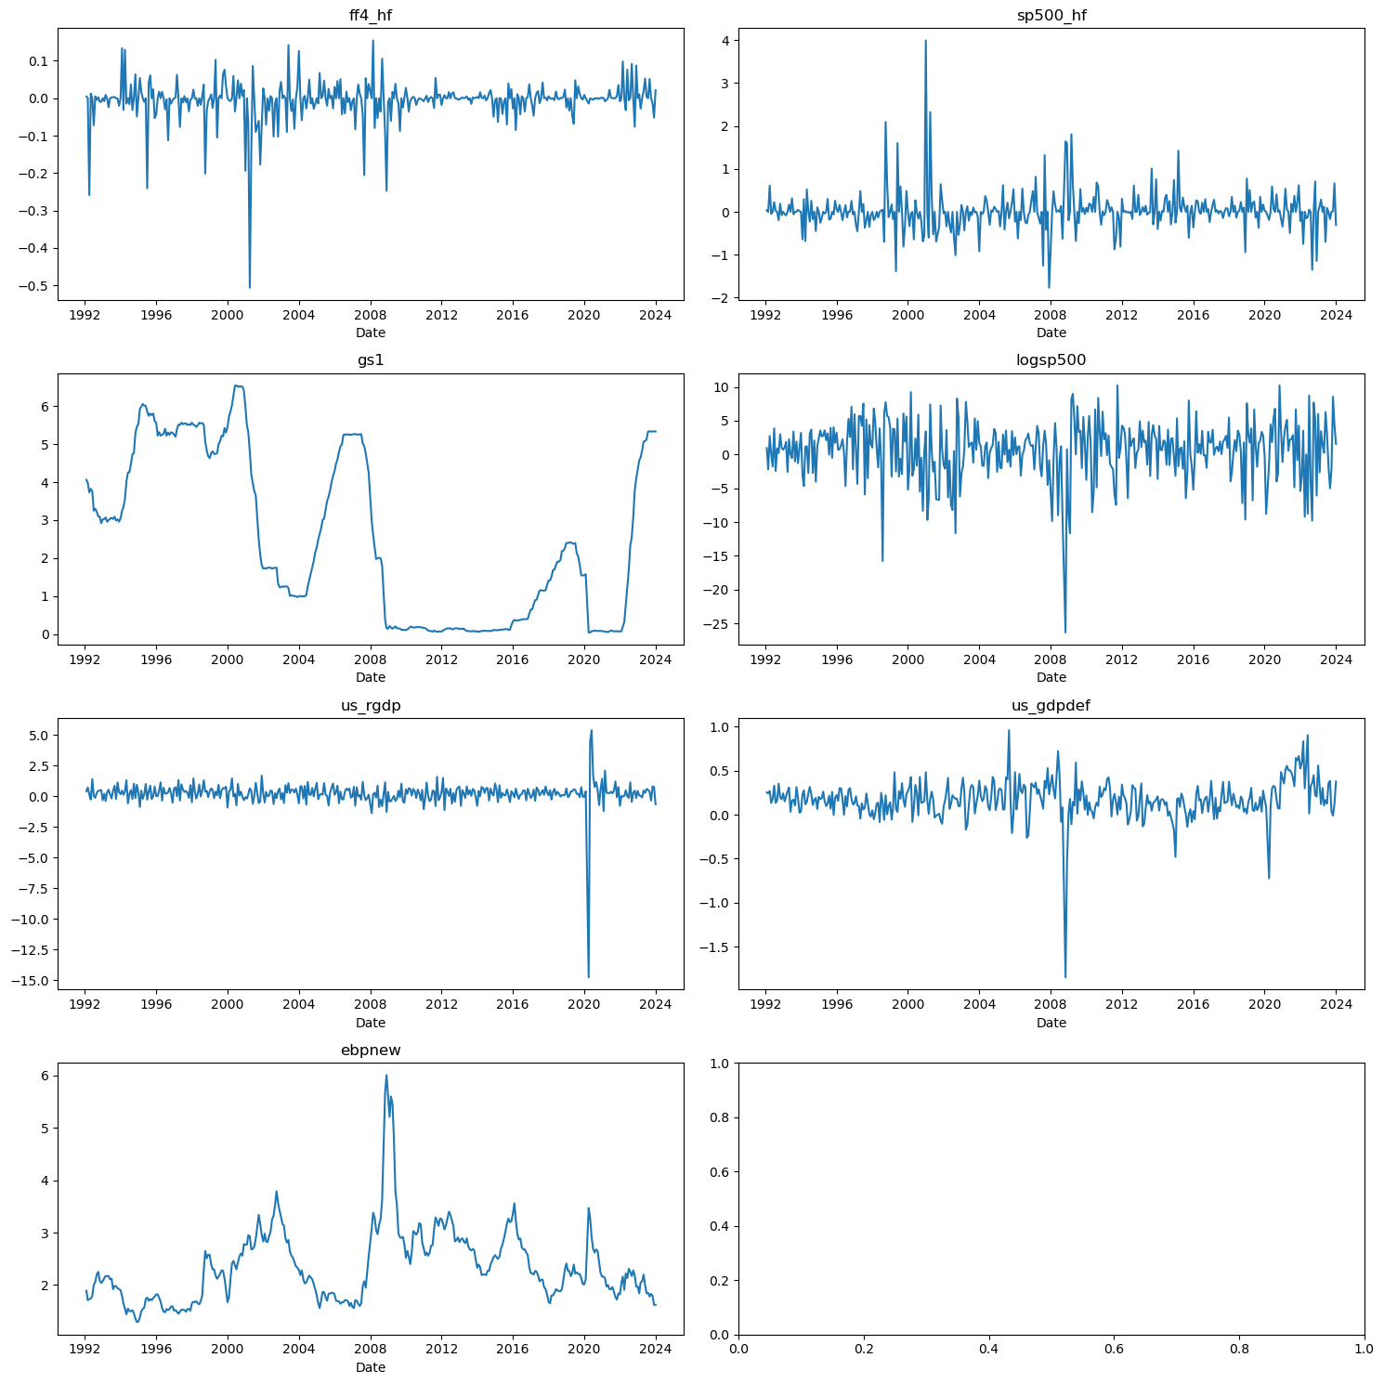

Slide 21
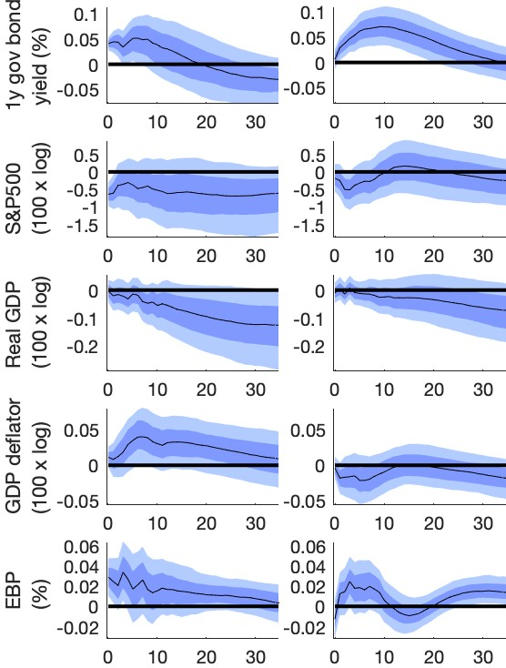
IRFs
Monetary Policy
(negative co-movement)
CB Information
(positive co-movement)
Monetary Policy 1-sdev shock is initially associated with:
5 bps increase in 1yr treasury yields, reverts to 0 in ± 11 months
75 bps decrease in stock prices , stays at new equilibrium
Real GDP persistent decline of 20bps
Price level increases by 12bps and reverts to 0
3 bps increase in EBP, eventually revert to 0
Monetary Policy irfs have larger variance
Inflation Puzzle
Differing Results to original paper
Notes:
More variance in Monetary Policy shock
Decline in real GDP to new equilibrium
Different results than original paper
Inflation puzzle seems to have opposite behavior than in paper
Affects are more similar than in paper:
Due to Variable creation

Slide 22
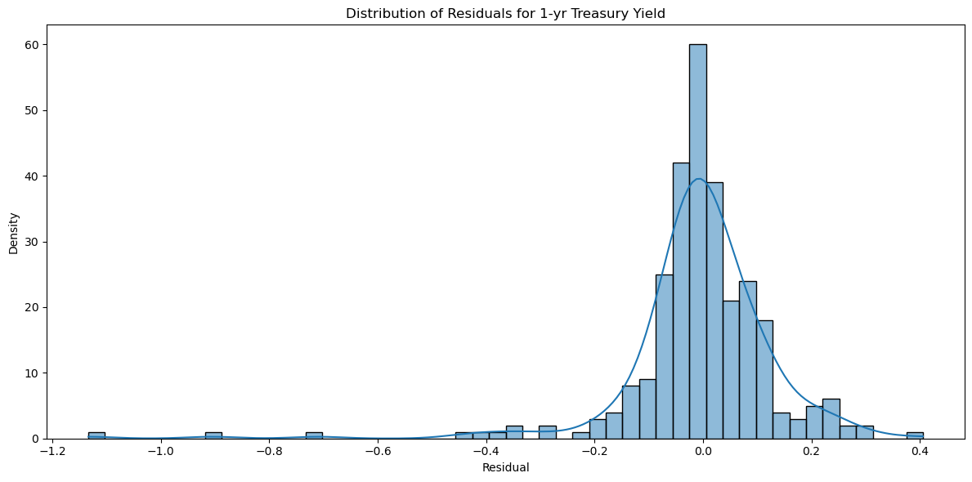
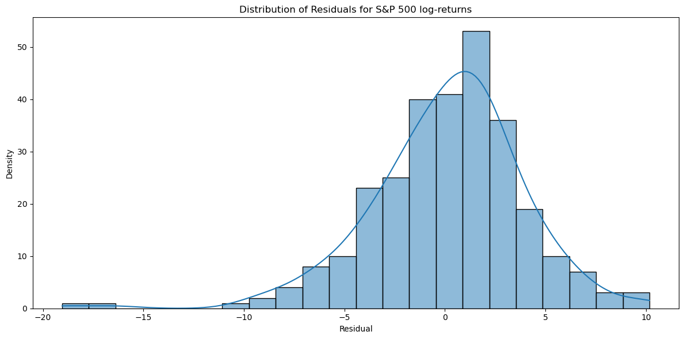
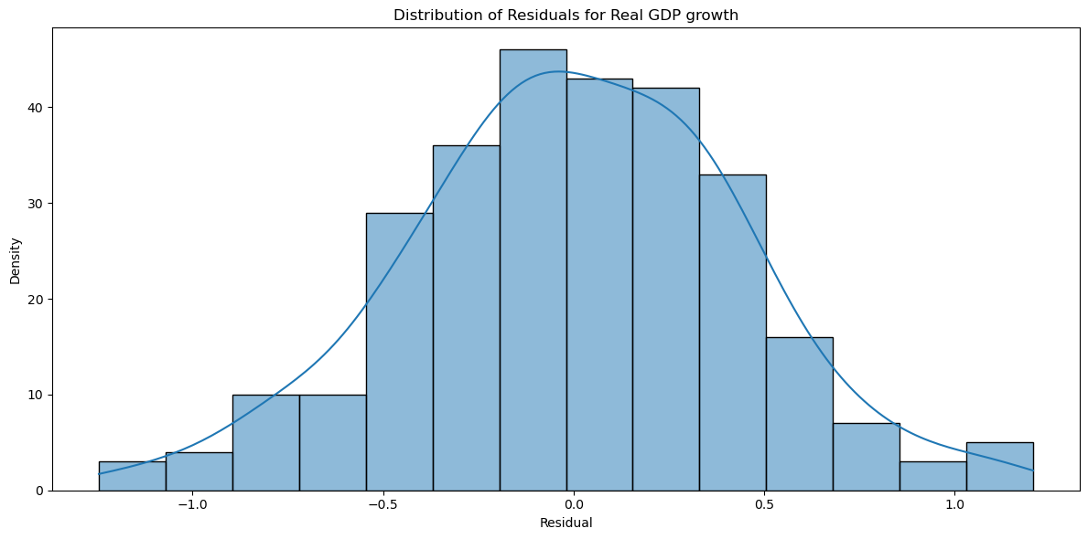
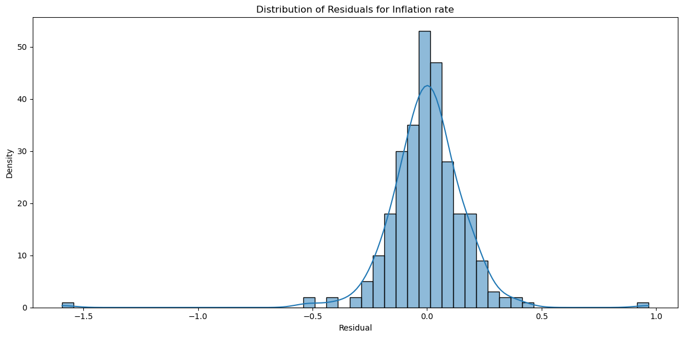
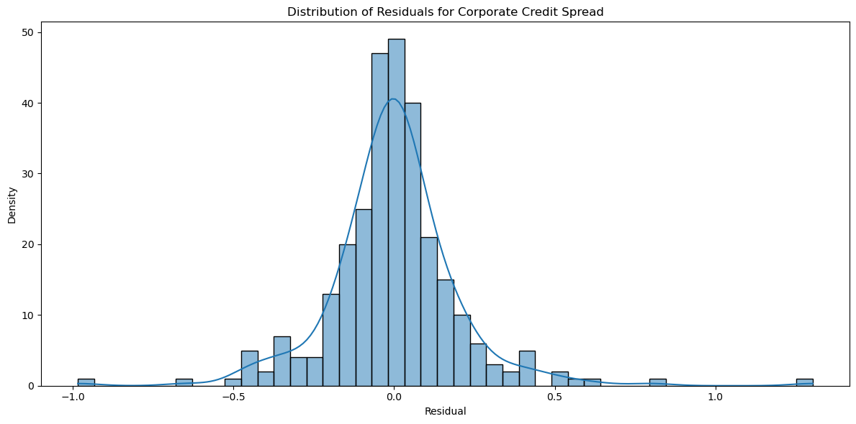
Diagnostic Tests

Slide 23
Industry Decomposition

Slide 24
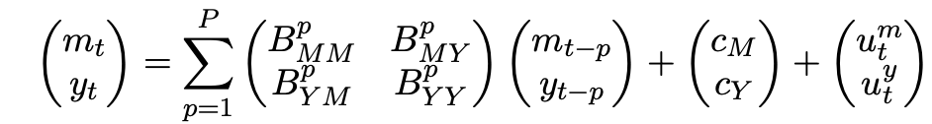
Limitations
What if shocks are not mean 0? Previous surprises condition future expectations:
Fed Funds are a poor measurement of monetary policy
Taylor rule increases interest rate in “good” state of the economy
Target rate = Inflation + Real rate + 0.5(inflation gap) + 0.5(output gap)
In “good” state, stock market and futures co-move, so co-movement is expected and simply indicates that Monetary Policy works
We can find if the link is causal but most likely cannot be used a CB policy tool (“withholding info”)

Slide 25
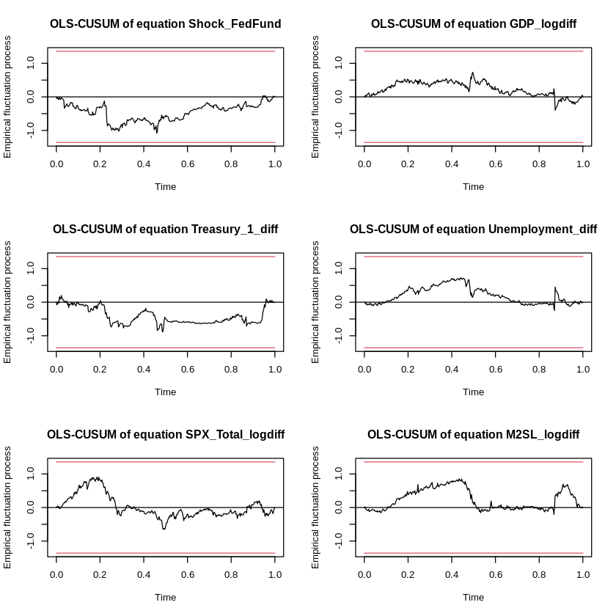
Appendix

Slide 26
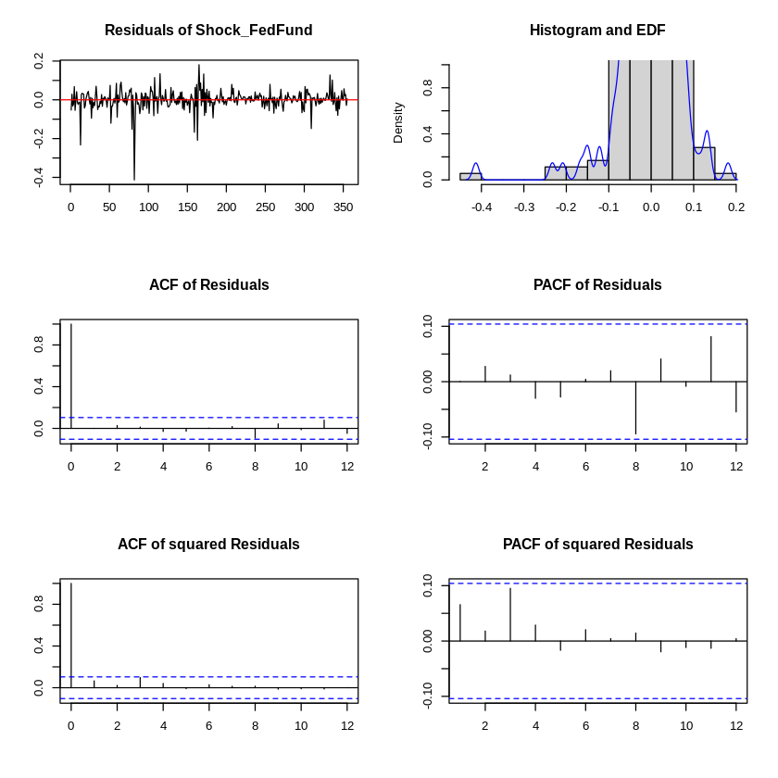
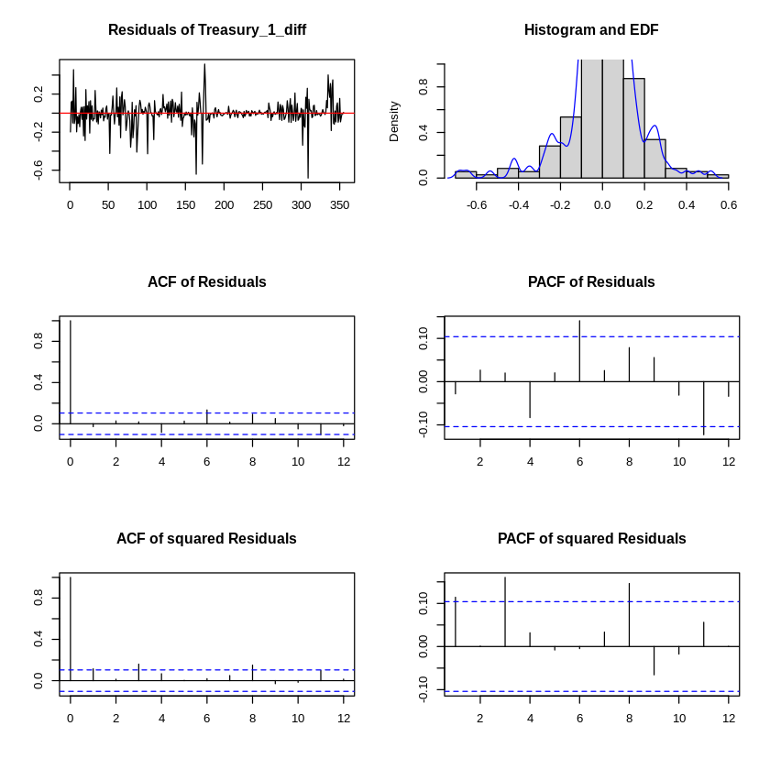
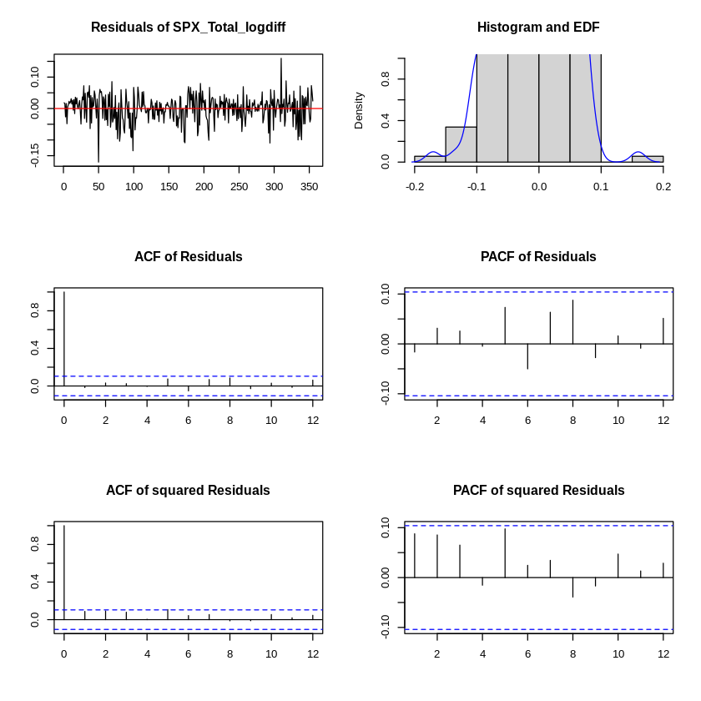
Appendix

Slide 27
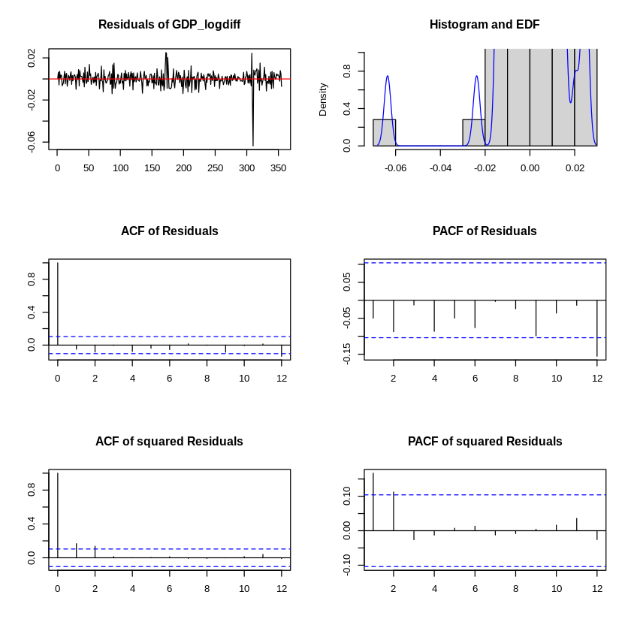
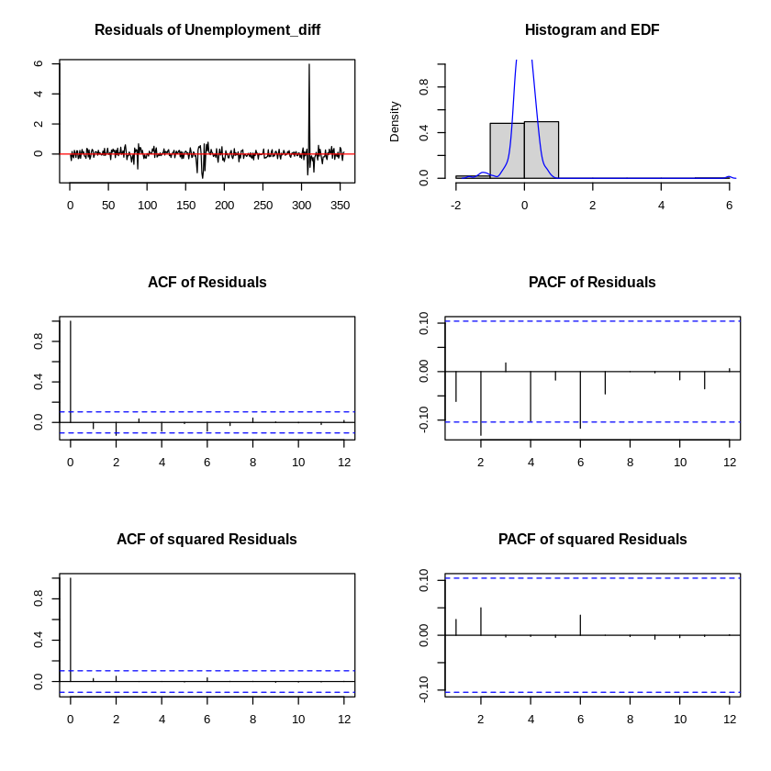
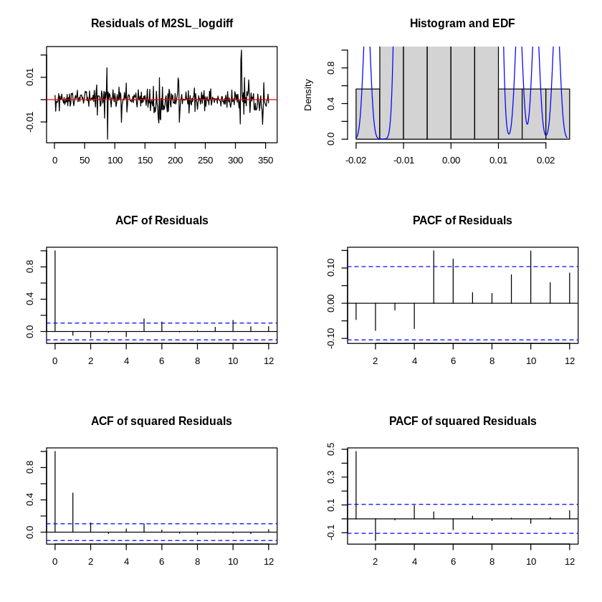
Appendix

